Slide 1
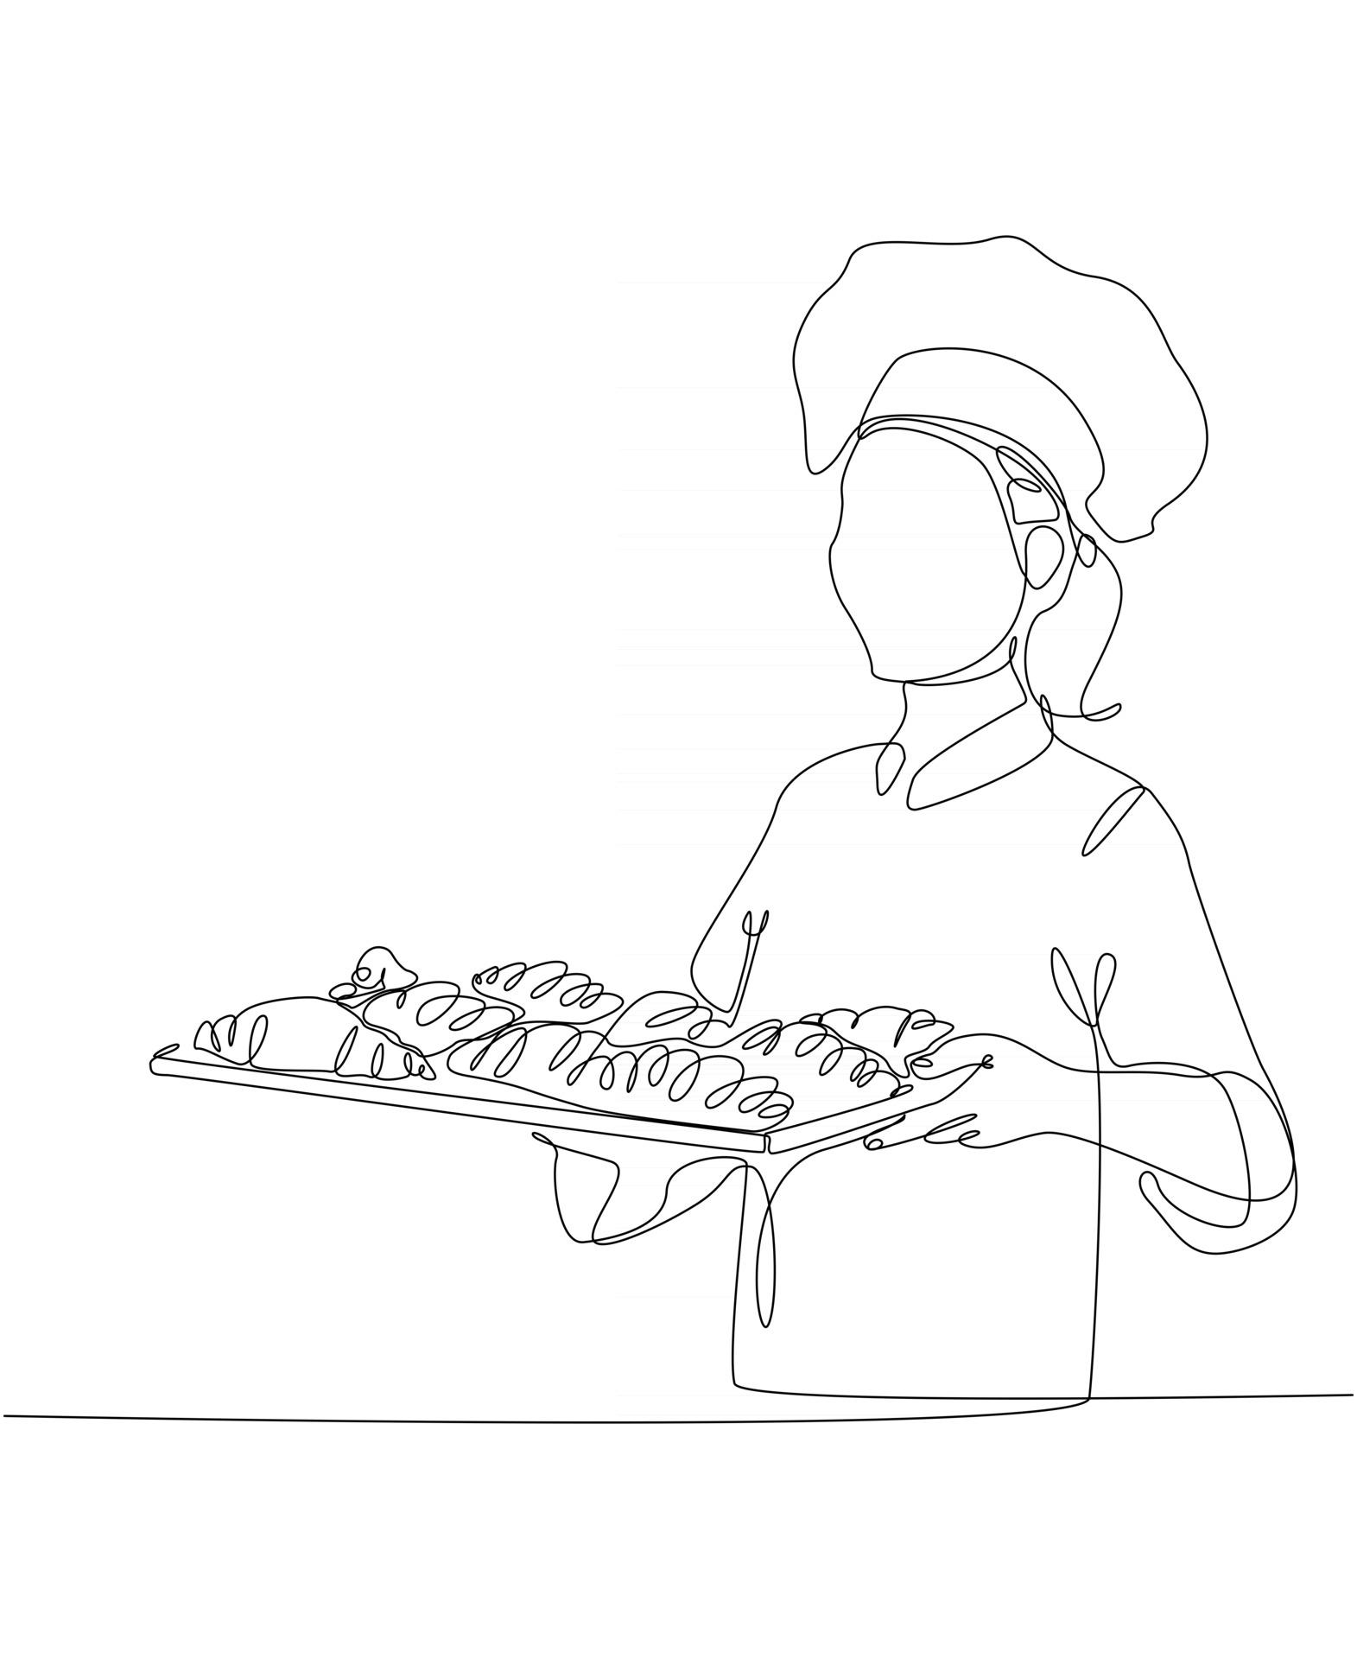
Restaurants
and
Hotel Job
Management System
Database Management Systems Laboratory
CSE 3522
Section : A

Slide 2

Group Members
Ayesha akter siddiqa
011 192 068
Farhana Hossain
011 193 004
Maruf ur Rahman
011 193 019

Slide 3
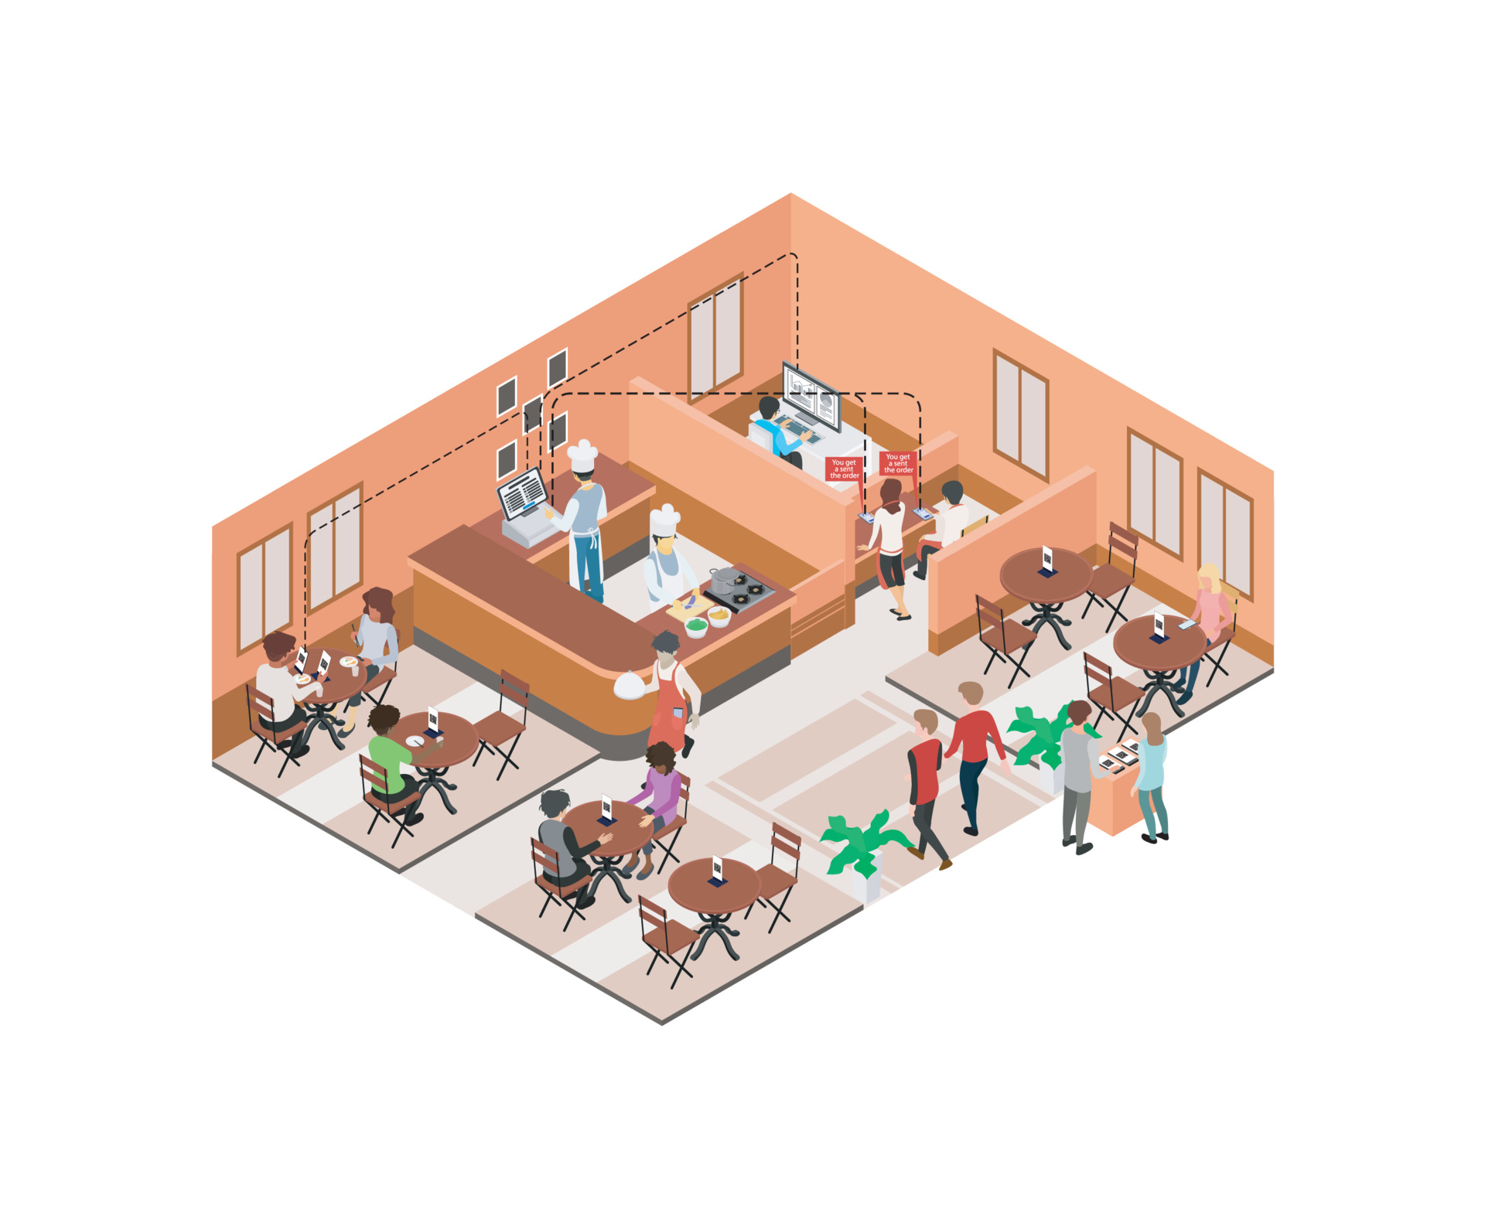
What exactly is going on here?
Basically,
It is a job portal website only for restaurants and hotels job

Slide 4

Project's motivation, objectives, and goals !!!

Slide 5

Existing System??
There is no specific online job site for restaurants and hotels, but there are several job portals for all types of jobs.
Bdjobs.com
Bd-career.com
Chakri.com.bd
Alljobsbd.com etc.

Slide 6

Proposed System??
This project is mostly focused on jobs in restaurants and hotels.
All types of restaurant & hotels
All types of restaurant & hotels jobs

Slide 7

What does it solve !!!!
It solves the problem of unemployment.
Helps people to get the job in the restaurant sector
Restaurants can locate competent employees.
Helps students to find part-time jobs

Slide 8

Features
easier to get jobs.
apply for others jobs.
Chefs can apply for the suitable jobs according to their category.
find the chefs more and worker effectively .
hire other staff .
all types of Restaurants & Hotels and all types of jobs
apply for the part-time job.

Slide 9
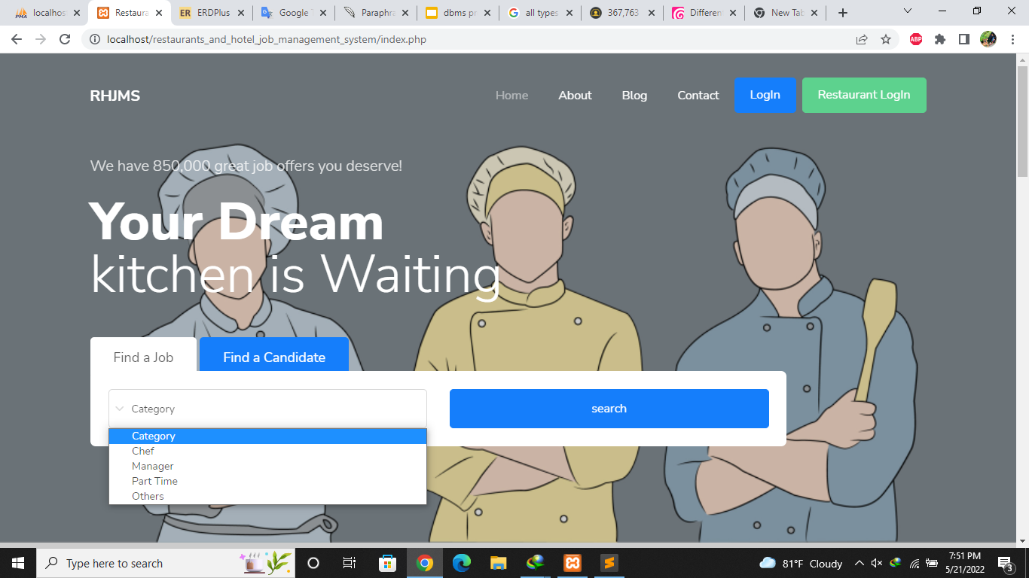

Working process of our project

Slide 10
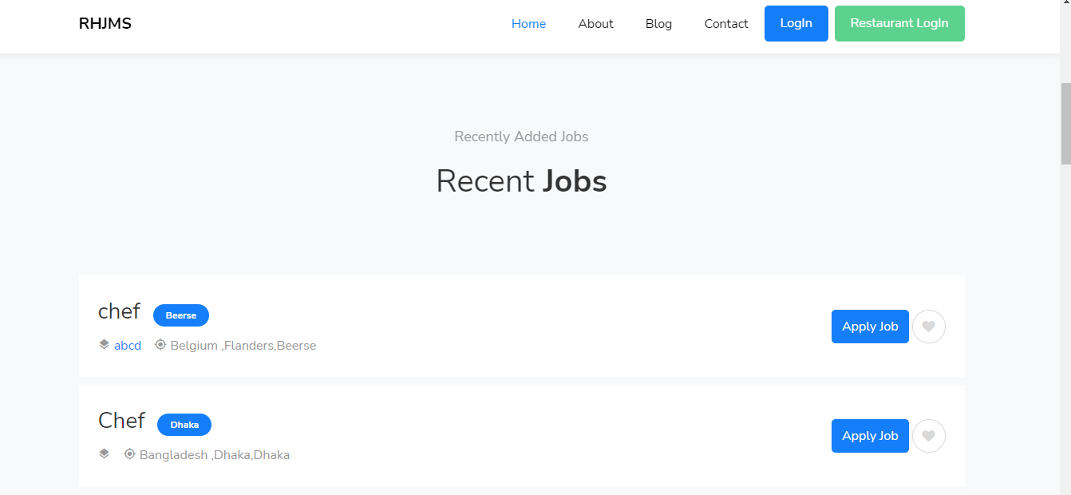

Slide 11
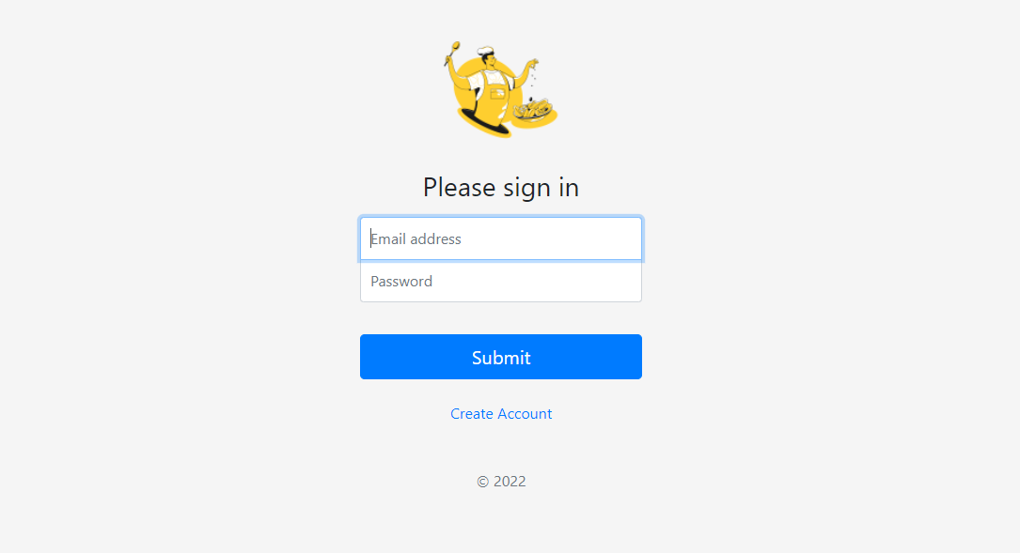
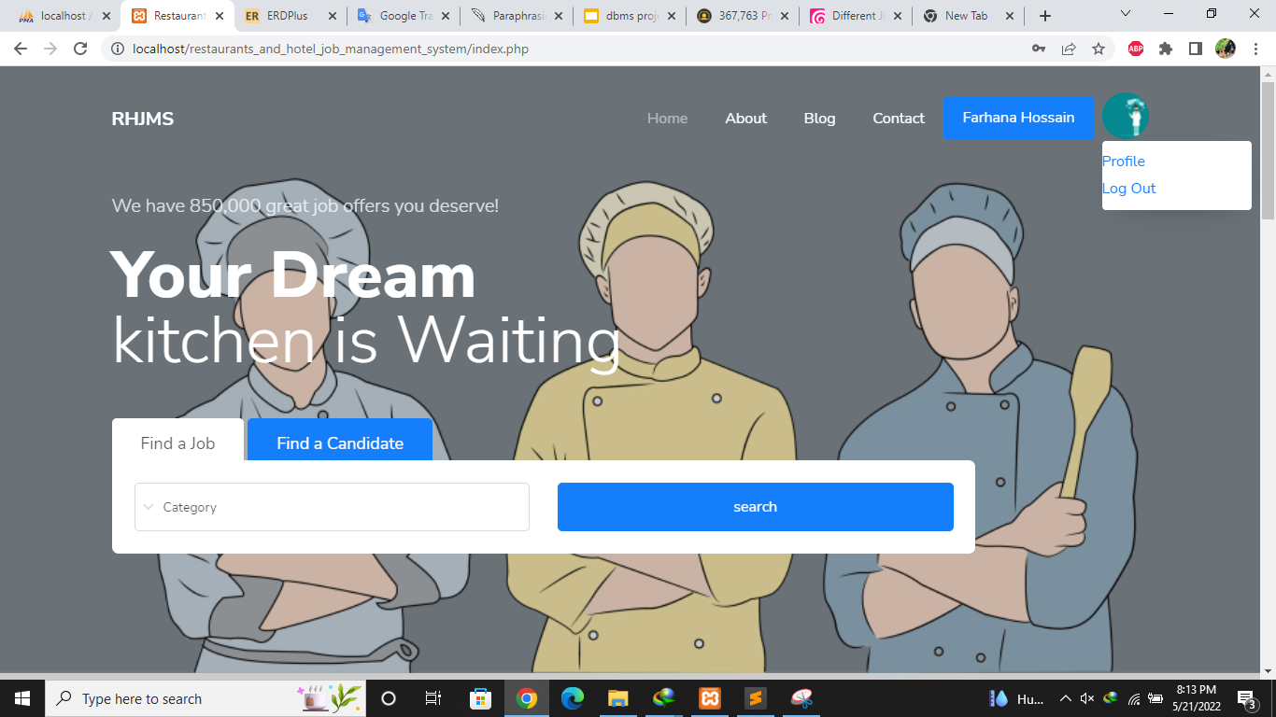
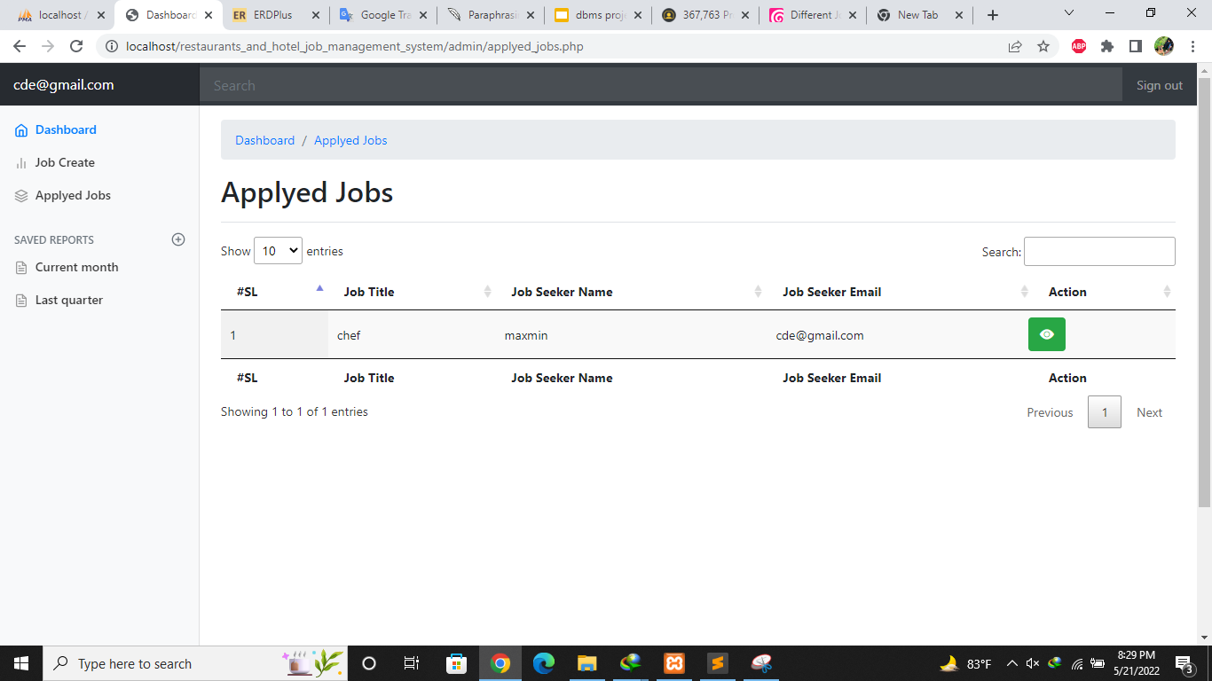
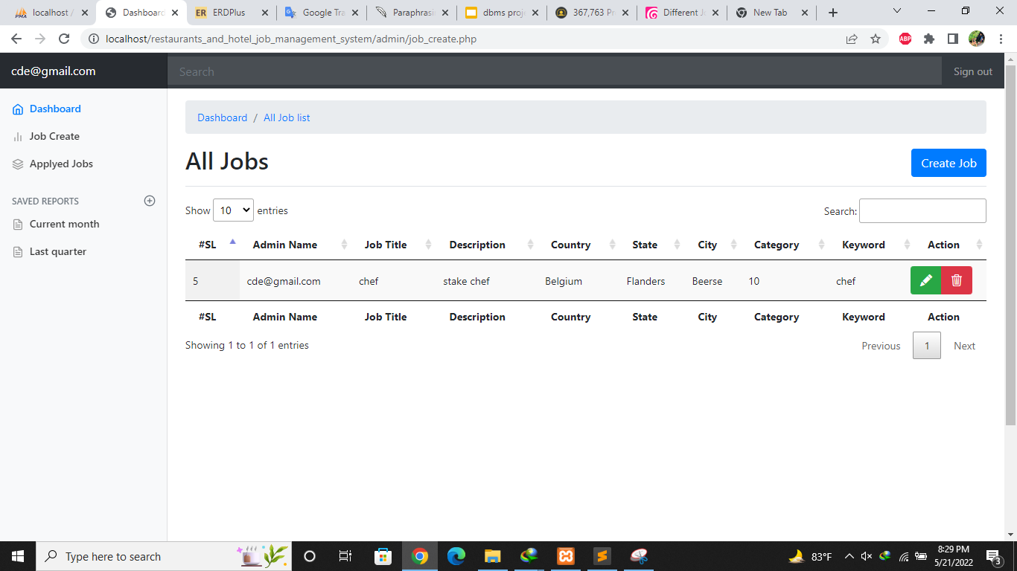
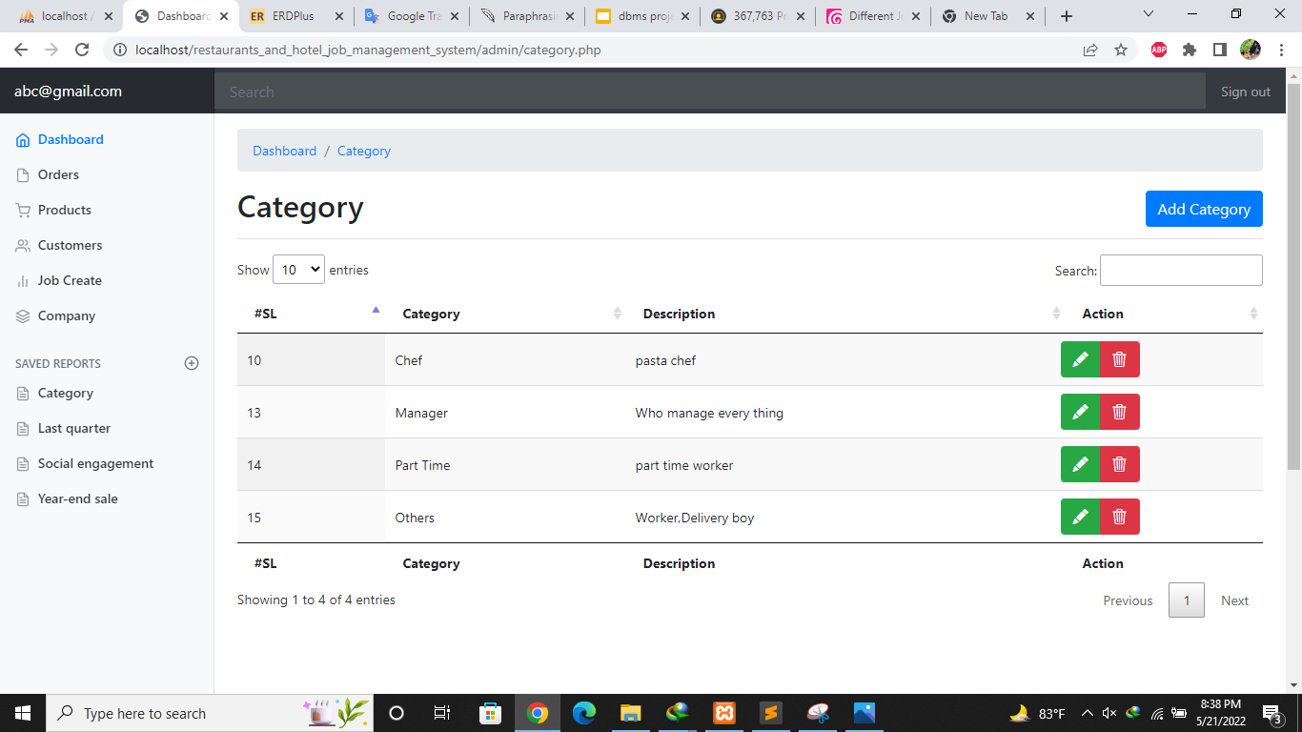
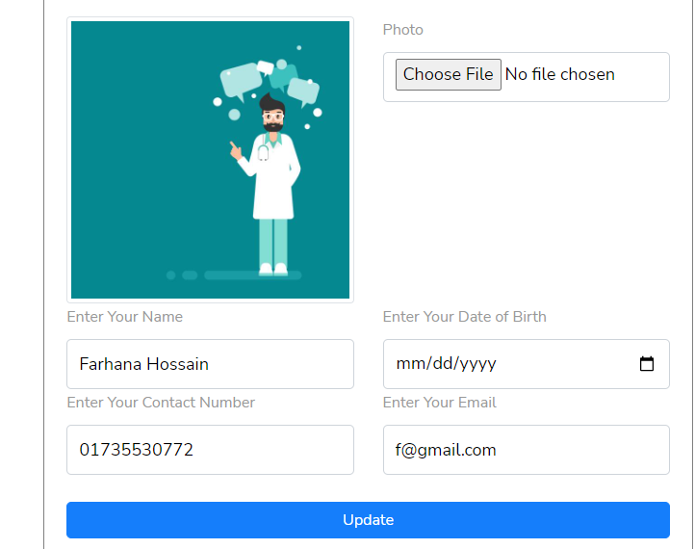
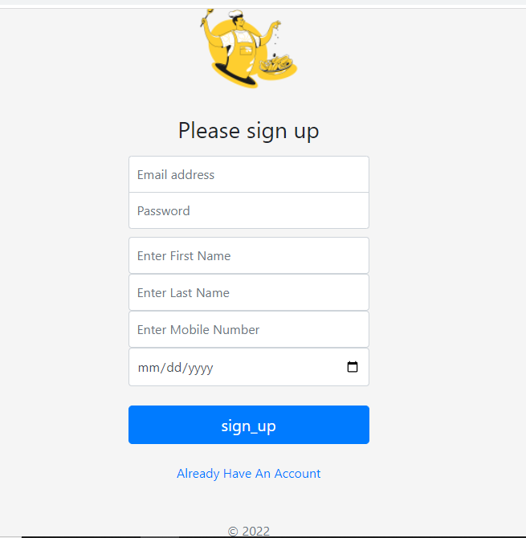

Slide 12
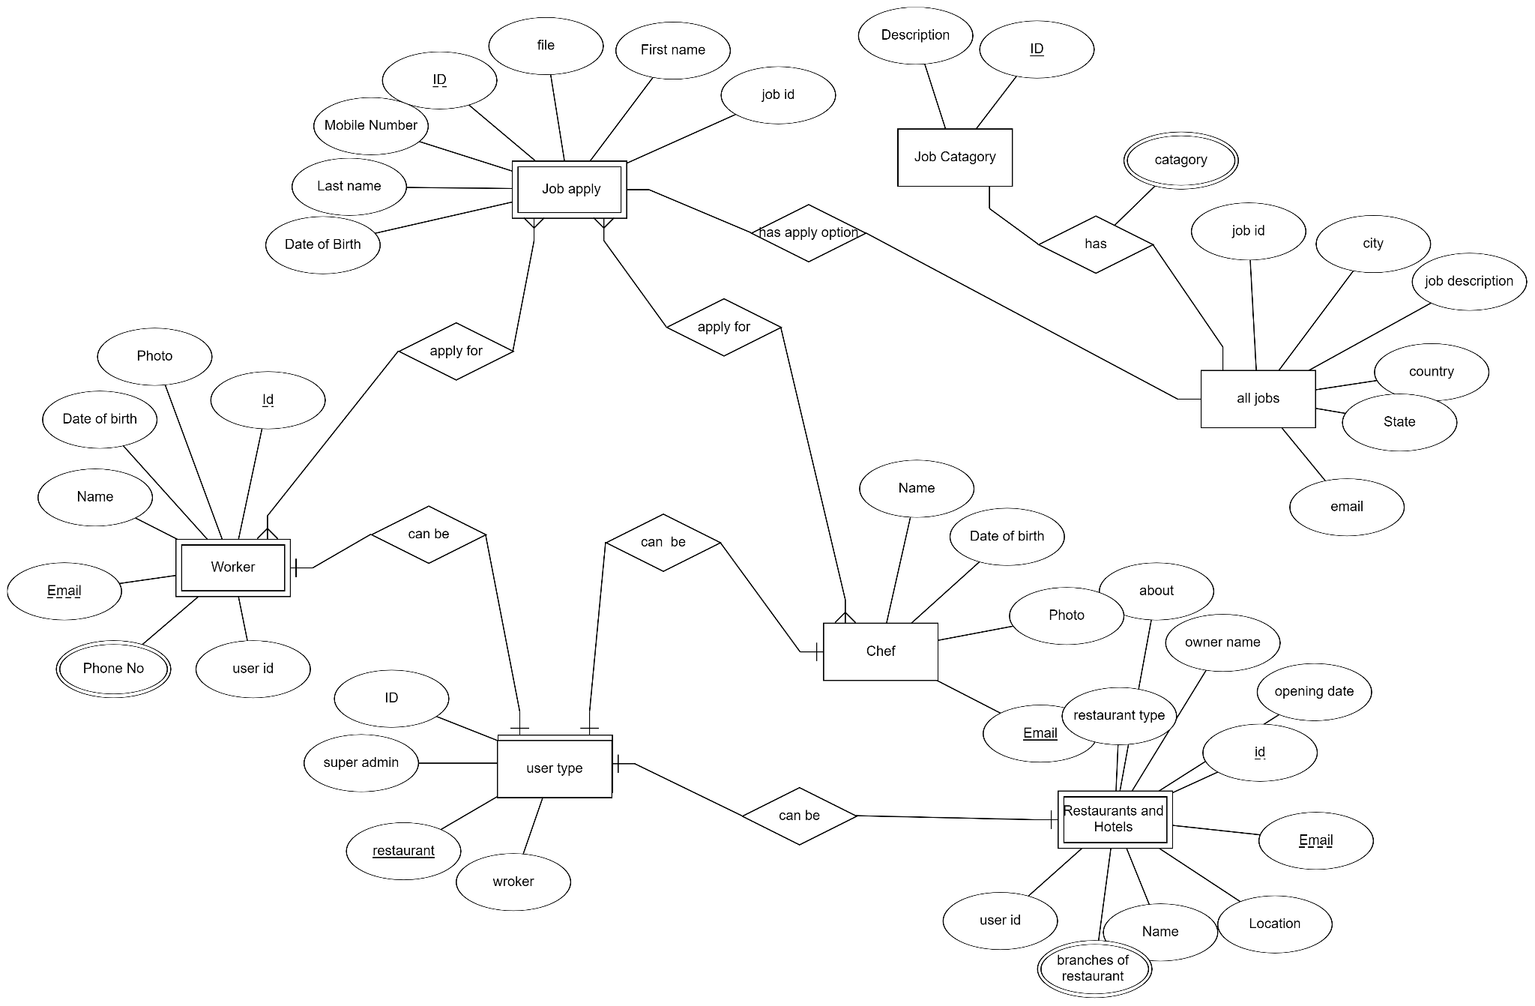
ER Diagram

Slide 13
Query
join

Slide 14
Future update
Online food order & online seat booking for a hotel or restaurant.
Restaurant Inventory Management.

Slide 15

Platform
MySQL
For database
PHP & HTML
For web development
CSS , js & bootstrap
For Design

Slide 16

Thank You

